Slide 1
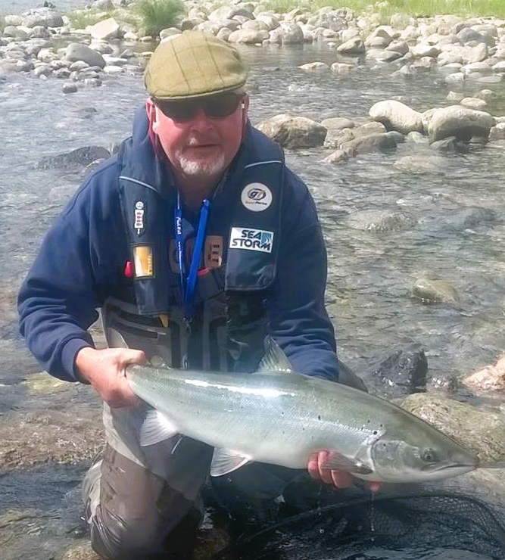
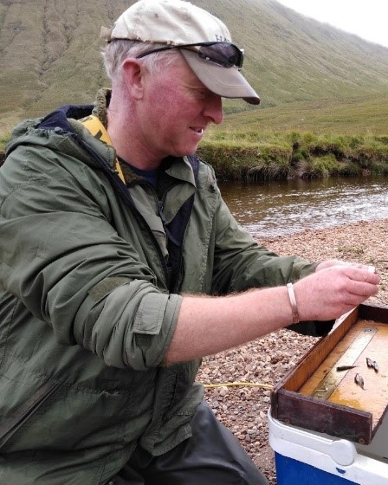
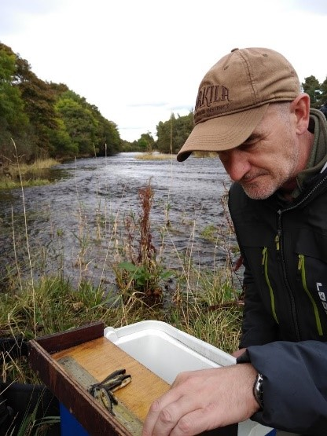
Ness District Salmon Fishery Board
The Team
BRIAN SHAW - DIRECTOR
JOHN MACOLL – HEAD BAILIFF
CHRIS DAPHNE - BIOLOGIST

Slide 2
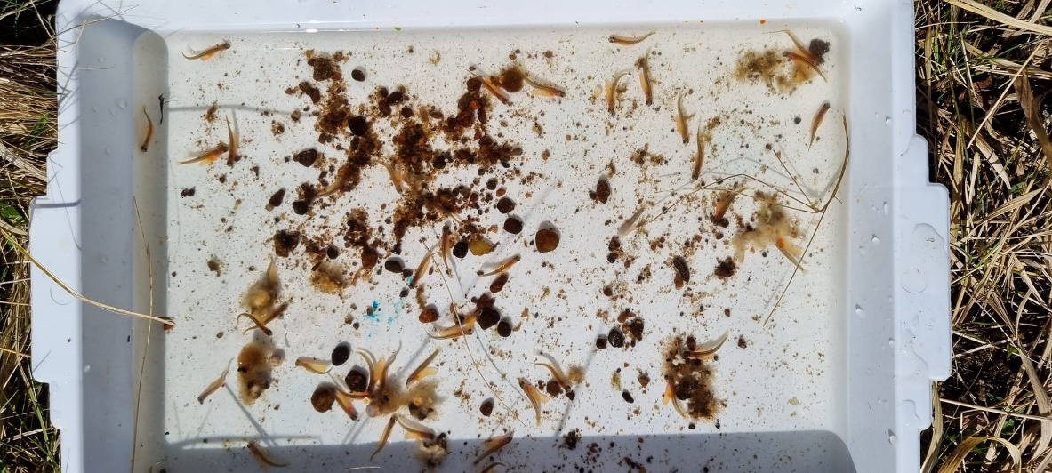
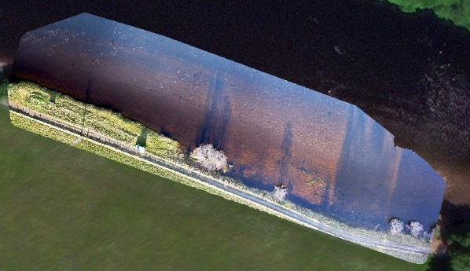
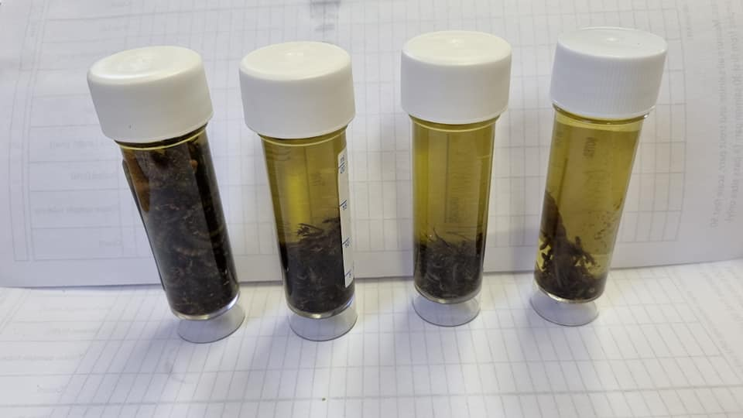
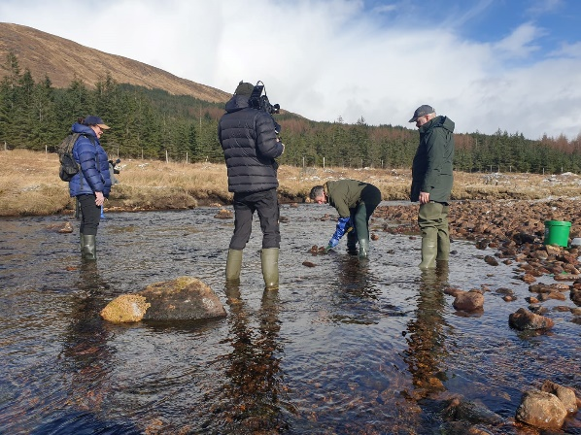
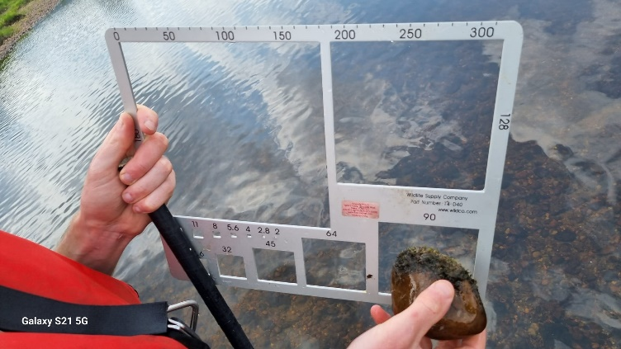
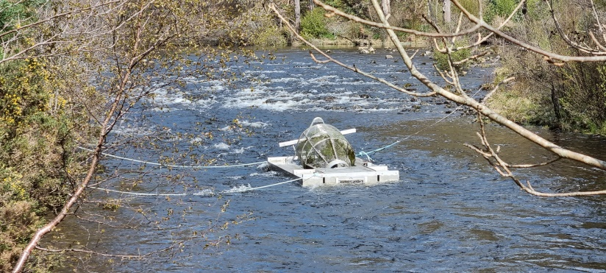
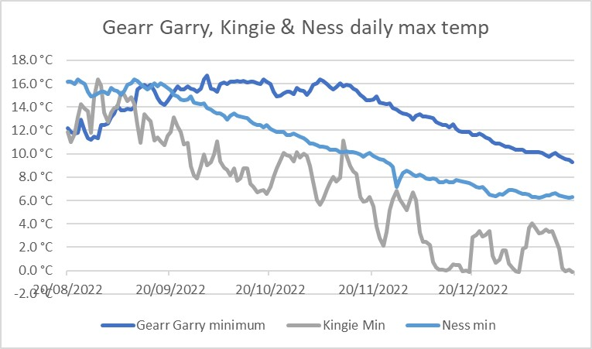
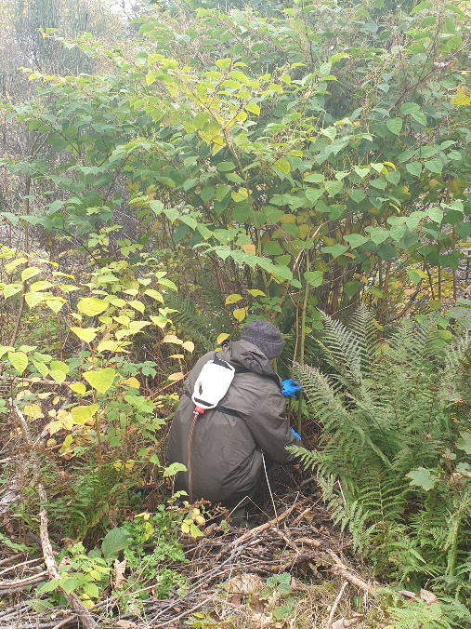
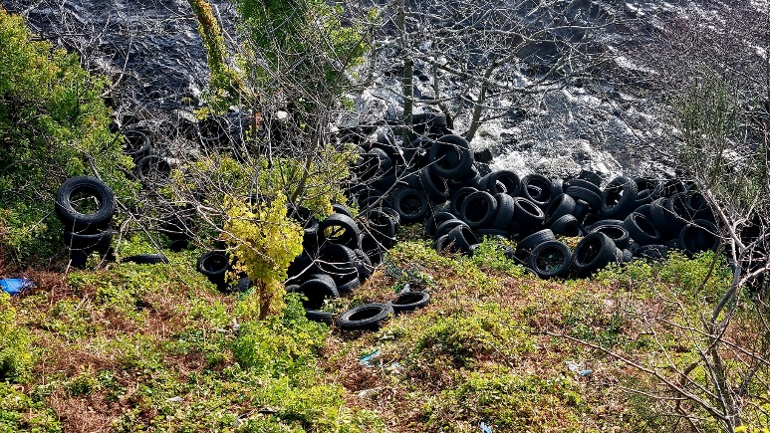
2023

Slide 3
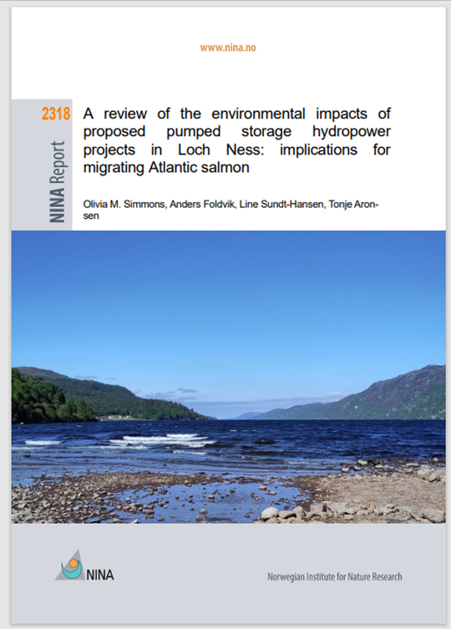
The Big Issue
PUMP STORAGE HYDRO
Cumulative impacts if three schemes are operational:
Loch Ness water level change up to 730mm (2ft 5”) on a daily basis according to planning documents
Typical daily drawdown may be in the order of 500mm (20”)
Daily inflowing water movements of 812m³/s, greater than highest flow ever recorded in River Ness
Daily outflowing water movements of ~700m³/s – around 20 times greater than typical flow down river Ness during salmon smolt run.
“PSH operation means that the minimum level in Loch Ness will be approached more often, but the absolute minimum level would not significantly change” Mott Macdonald - Loch Ness PSH – hydrological modelling (15.27m)
www.energyconsents.scot – simple search ‘Loch Kemp’ or by ref number –ECU00003398
#SAVELOCHNESS

